Slide 1

Purdue Process Safety & Assurance Center (P2SAC)
Overview
Ray A. Mentzer
Professor of Engineering Practice
Associate Director, P2SAC
Charles D. Davidson School of Chemical Engineering Purdue University
May 6, 2026

Slide 2
May 2026 Conference Registration
Guests
Abbvie
Air Products
CCPS
Curia Global
DEKRA
Dupont*
Gilead
Jensen Hughes
Kiewit
Marathon Consulting
Merck
Millipore Sigma*
Phlow Pharma*
Promega
Shell
Wacker Chem*
Yuhan*
3M
*denotes 1st meeting
Sponsors
ACC – Am Chem Council
AcuTech
AMGEN
Corteva
CountryMark
Dow
Evonik
ExxonMobil
Fauske & Associates
GSK
Honeywell
Johnson Matthey
Kenexis
Lilly
Pfizer
PSRG
SABIC
Safety&
Takeda
Thermal Hazard Tech
Vertex
On-going dialog with other Depts:
ABE, CHEM, IE, IPPH & ME

Slide 3
Growing Industry Participation & Projects in P2SAC

Slide 4
Summer ‘26 Masters Process Safety Research Projects
-Heats of reaction for some common reaction types in pharma industry & comparison with CHETAH & TCIT predictions; Part XVI; on-going ~5 years (Amgen, Vertex, Lilly, GSK, Pfizer, Merck, …)
-Estimation of decomposition energies for organometallics - Part VII (Johnson Matthey)
-Analysis of reaction mixtures with liquid swelling and gas evolution (Johnson Matthey)
-Optimal Design of Process Safety Management Systems - Part II (PSRG)
- AI-Enabled PSM Tool (AcuTech)
- Determining Guidance for Compliance with 2024 Update to EPA RMP (Evonik)
- Human & Organizational Performance in Process Safety (Safety & Consulting Associates)
- Process Fault Detection via Quantum Computing (Prof Bernal & Venkat)
- Preserving Machine Learning for Predicting Compressor Failures in Energy – Intensive Chemical Processes (Prof Li & Venkat)-

Slide 5
Spring ‘26 Masters & UG Process Safety Research Projects
Spring PMP
-Heats of reaction for some common reaction types in pharma industry & comparison with CHETAH & TCIT predictions; Part XV; on-going ~5 years (Amgen, Vertex, Lilly, GSK, Pfizer, Merck, …)
- Site specific decision trees for handling unstable materials, Part II (Evonik)
- Creating a tool that will convert piping and instrumentation diagrams into standardized text in the DEXPI format (Kenexis)
- Dust Explosion Hazard Assessments (Dow, Lilly, Shell & Fauske)
- Optimal Design of Process Safety Management Systems - Part I (PSRG)
UG Projects
- Estimation of Heats of Formation & Combustion for Organometallics, Part VI (Johnson Matthey)

Slide 6

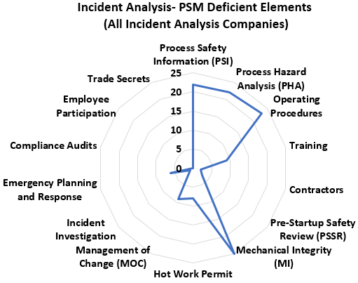
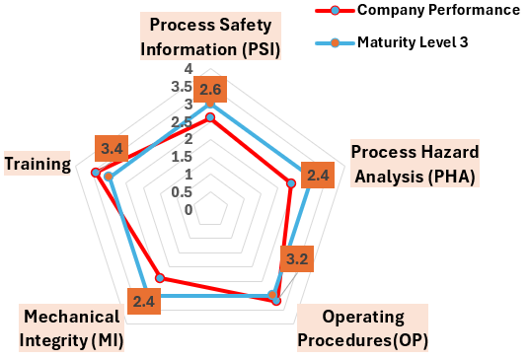
Designing a Scalable Process Safety Performance Measurement System for Companies at Different Stages of Process Safety Maturity​
Why
Reactive safety culture focused on compliance, not performance.
Fragmented data and inconsistent metrics across sites.
Repeat shortcomings in PSI, PHA, MI and OP.
The spider chart depicts the no. of companies that experienced incidents associated with failures in respective PSM element​ (Analyzed 30 CSB incidents from past 3 years).
How
Our Solution: The Process Safety Performance Measurement System.
Integrates global best practices into a single measurable system.
Use leading + lagging indicators to quantify performance.
Build a single integrated framework across 10 key process safety elements.
5 elements from OSHA 3908‑03 2017 Process Safety Management for Small Businesses (PHA, PSI, Training, MI and Compliance Audits).
5 elements from CSB incident investigations, RBPS and OSHA (MOC, OP, Permit System & Safe Work Practices, Contractor Management and Incident Investigation & Learning).
Convert raw data from a site into comparable maturity scores.
What
Identify weak elements (e.g., PSI 2.6, PHA 2.4, MI 2.4).
Strengthen strong areas (e.g., Training 3.4, OP 3.2).
Prioritize actions for all elements below Level 3.
Move plants from “reactive” to predictive performance.
Overall Maturity Level of the Pilot Case Study
Track what’s strong. Fix what’s weak.
Transform compliance into measurable performance.

Slide 7
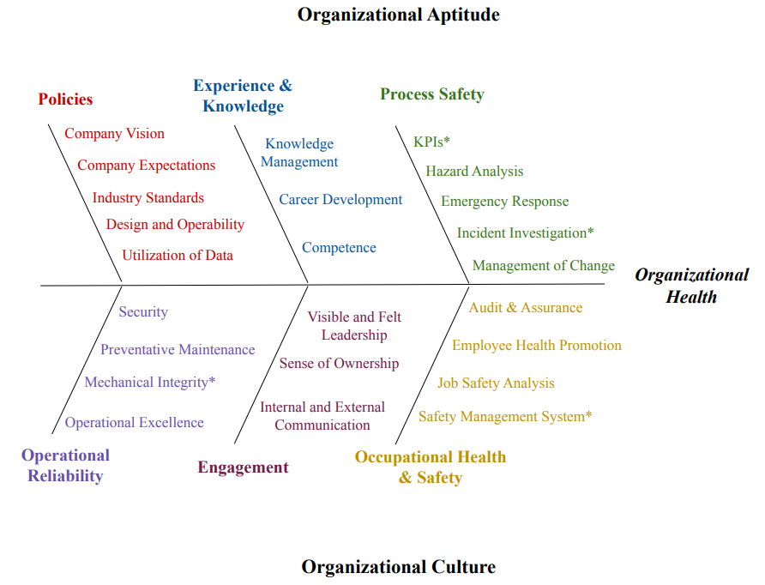
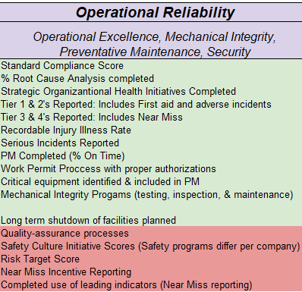

Organizational Health / Safety Culture – UG (w / ACC & Marsh)
‘An organization’s ability to align around a common vision, execute against that vision effectively, and renew itself through innovation and creative thinking.’ McKinsey & Co

Slide 8
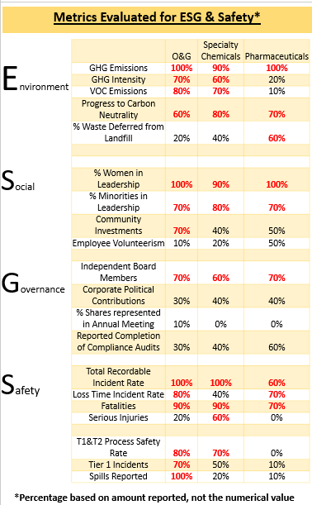
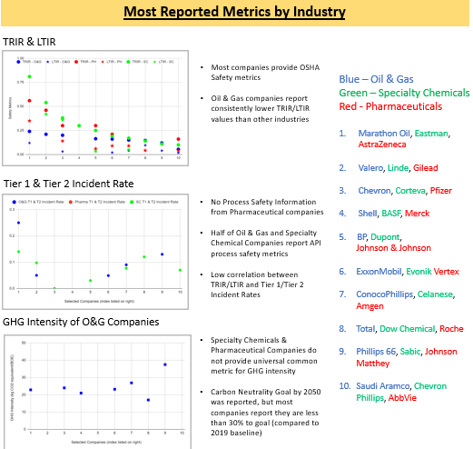

ESG (Environmental, Social & Governance Stewardship) – UG Research
- Investigated 10 of the largest companies in Oil & Gas, Specialty Chemicals, and Pharmaceuticals for reported ESG metrics.
- Looked at how available this information was for each company & industry, and then ranked them based on overall reporting – not numerical performance.

Slide 9
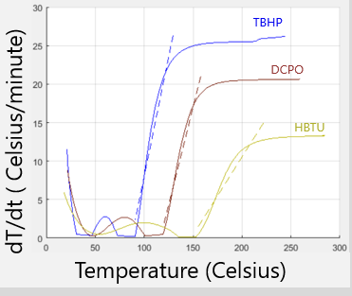
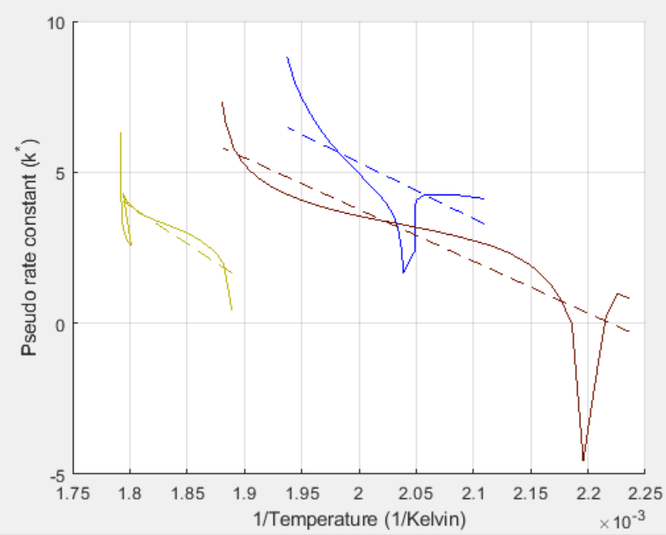
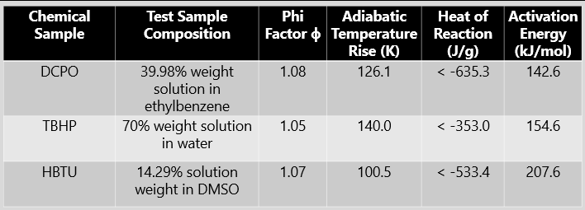
Thermal Analysis Using ARSST Calorimeter – UG Research
Dicumyl peroxide: DCPO
Peroxide: TBHP
(2-(1H-benzotriazol-1-yl)-1,1,3,3-tetramethyluronium hexafluorophosphate: HBTU

Slide 10
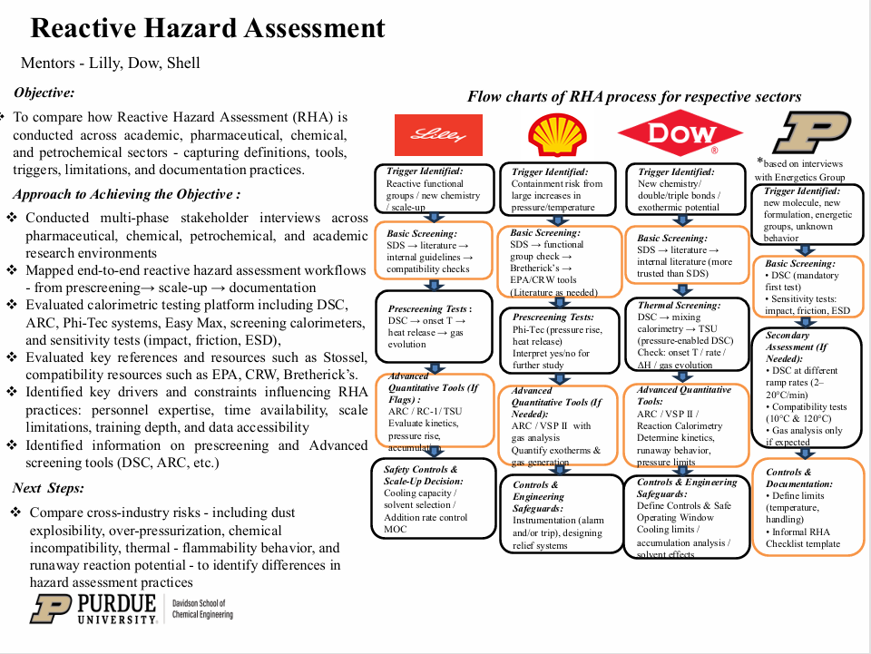

Slide 11
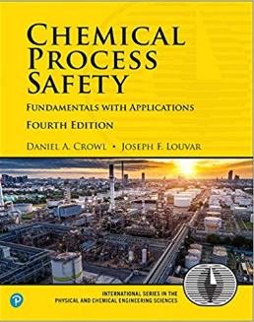
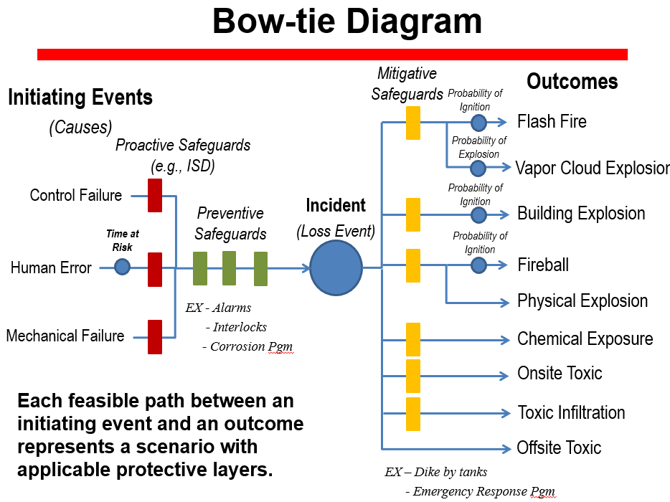
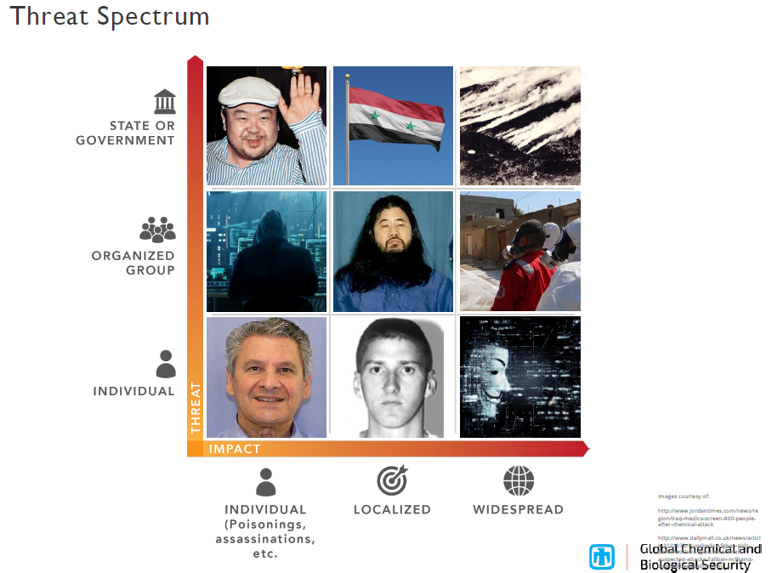
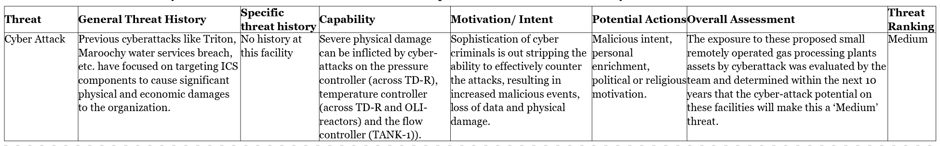
Chemical Process Safety - Core Class
Personnel vs. Process Safety
Applicable regulations: OSHA
PSM, EPA RMP, etc
Source Term Modeling
Toxicants & Industrial Hygiene
Toxic/Flammable Gas Release
Dispersion Modeling
Fire & Explosion Protection
Chemical Reactivity
Relief System Design
Hazards Identification (HAZOP, ..)
Risk Assessment (Matrix, QRA, ..)
Accident Investigations
Emergency Response
Chemical Facility Anti-Terrorism Standards (CFATS) … and Chemical Security …
HAZOPs & Cyber Security

Slide 12
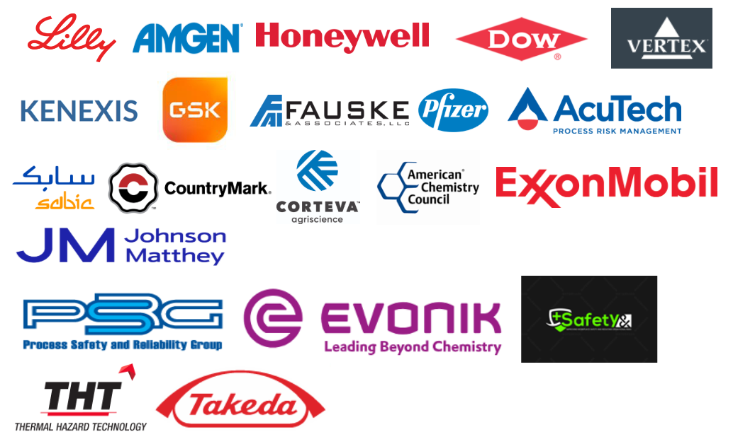
P2SAC Corporate Sponsors

